Slide 1
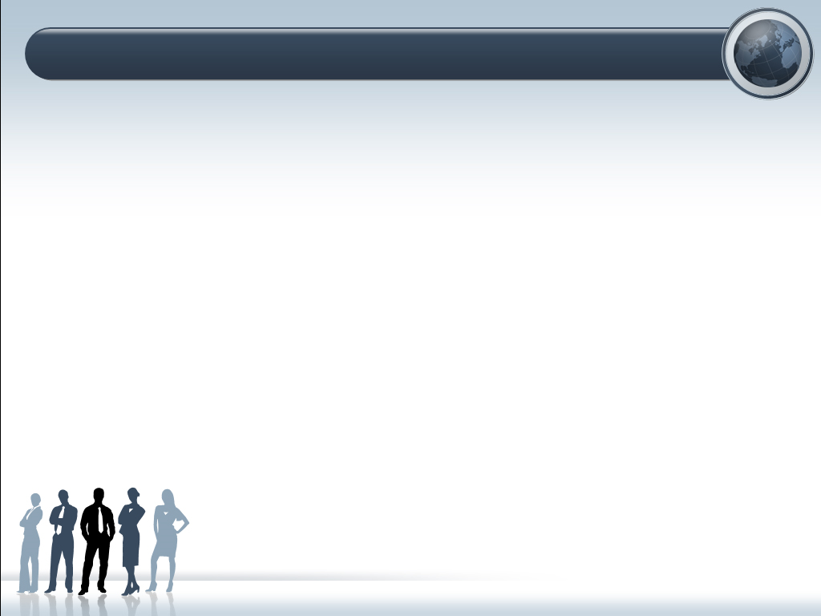
Team-57
MEDICAL ASSISTANT
Members:-
Sarwang (19csu279)
Satyam (19csu281)
Shashank (19csu285)
Shivani (19csu294)
Shreyansika (19csu300)

Slide 2
MEDICAL ASSISTANT
Medical assistant is responsible for everything from administrative work to patient and physician support tasks at hospitals.
This project discusses about the Online Medical Assistance.
This system is split into three main parts that comprise of Patient’s Registration and creating patient's ID, diagnosis and display list of possible disease consistent with the symptoms entered by user and display accurate symptoms based on the disease entered by patient or user.

Slide 3
SIGNIFICANCE
Reduces cost and time significantly.
More flexible and provide a higher level of service.
Patient can get 24 hour access.
Can offer services to a large number of patient residing anywhere in world.
Helps to formulate an efficient and reliable healthcare plan.

Slide 4
OVERVIEW OF PROJECT
MEDICAL ASSISTANT
Medical Data Base
Name
Age
Gender
Contact No.
Medical Assistant Pannel will open only if the above mentioned details are valid.
Automatic ID will be generated.
Menu
Symptom
Disease
(Symptoms will search in text file and if the symptom entered by user is present in text file then only it will execute else it will display “Unrecognized Symptom Exception” )
(Disease will search in text file and if the disease entered by user is present in text file then only it will execute else it will display “Unrecognized Disease Exception” )
Database CSV

Slide 5
SPECIFICATIONS
Age Validation: Age should be greater than 0 and less than 150.
Gender Validation: The user should enter only 'M','m','F','f'.
Contact Number Validation:
The contact no. should not contain values more than 10.
No. could have 0 or 91 in starting other than the 10 digits.
No. could have “+” before 91
No. could have - after 91
File Name Validation:
System should ask to enter valid file name for source csv file.
Source file extension should be only ".csv".
The source file should not contain special characters.
Source file name should not be empty.
Source file name should not exceed 20 characters excluding file
extension part.

Slide 6
PROJECT DIRECTORY
STRUCTURE

Slide 7
├── classes
└── src
└── ncu
├── exceptions
├── java
├── main
└── validations
├── configs
├── constants
├── csvs
├── src
└── ncu
├── exceptions
├── java
├── main
└── validations
└── txt
├── diseases
└── symptom

Slide 8
The project directory structure explains all subdirectories and files to be kept into particular sub directory.
classes- This folder contains all the class files.
configs- This folder contains config subfolder.
> constants --> exception.properties
csv- This folder contains csv file.
src- This folder should contain different packages and source files based on their actions.

Slide 9
>src.ncu.main
This will contain main java source file.
Medical Data Base
>src.ncu.validations
This will contain validators source files.
Age Validation
Gender Validation
Contact Number Validation
>src.ncu.exceptions
This will contain exception source files.
Unrecognized Disease Exception
Unrecognized Symptom Exception
Empty File Name Exception
Missing Extension Exception
Csv Only Exception
Long File Name Exception
Special Character Exception

Slide 10
>src.ncu.java
This folder contains the file handling
Csv writer
Find
Show Output
Screen Clear
txt- This folder contains all the text files .

Slide 11
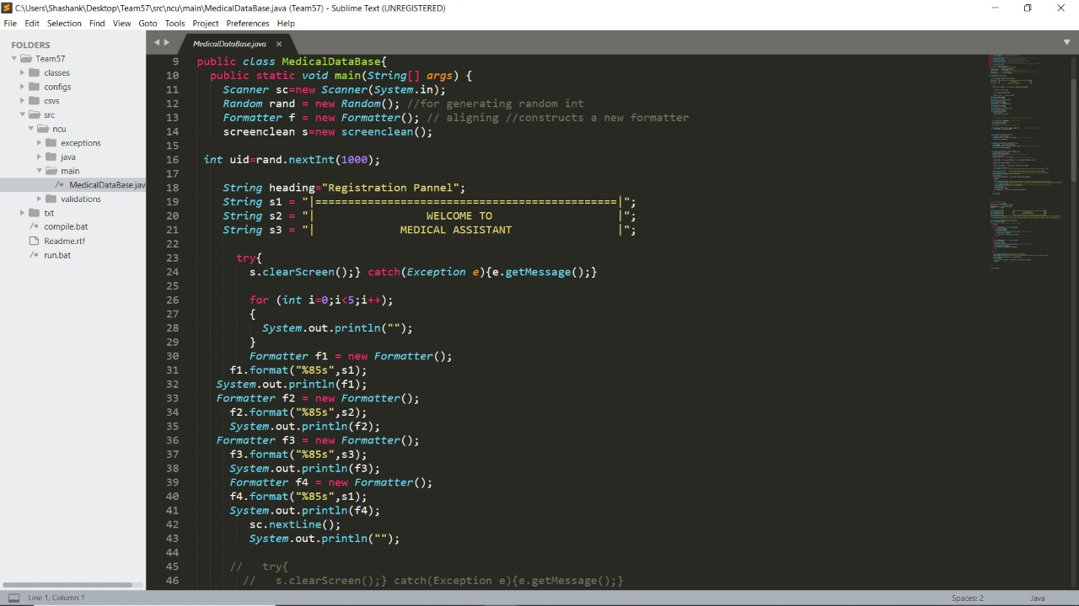
WELCOME PAGE
For loop here is used to provide space

Slide 12
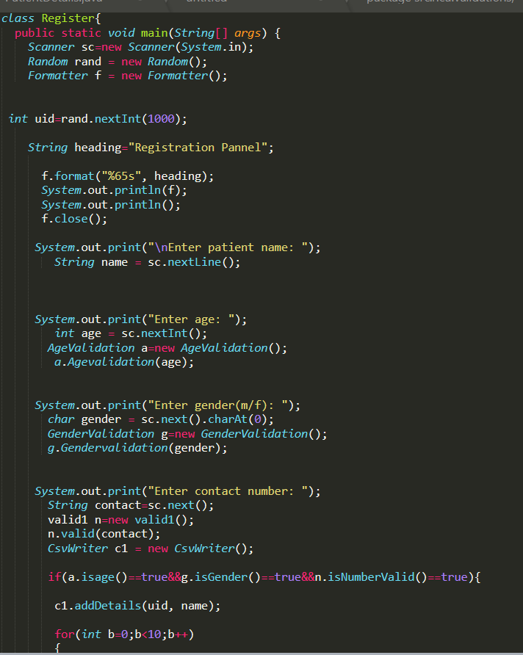
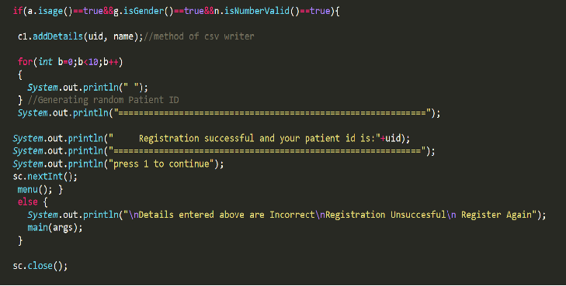
MEDICAL DATA BASE
Generating random ID
Genrating random patient id
Object of age validator
Object of gender validator
Object of contact validator
object for Csv Writer class
method of csv writer

Slide 13
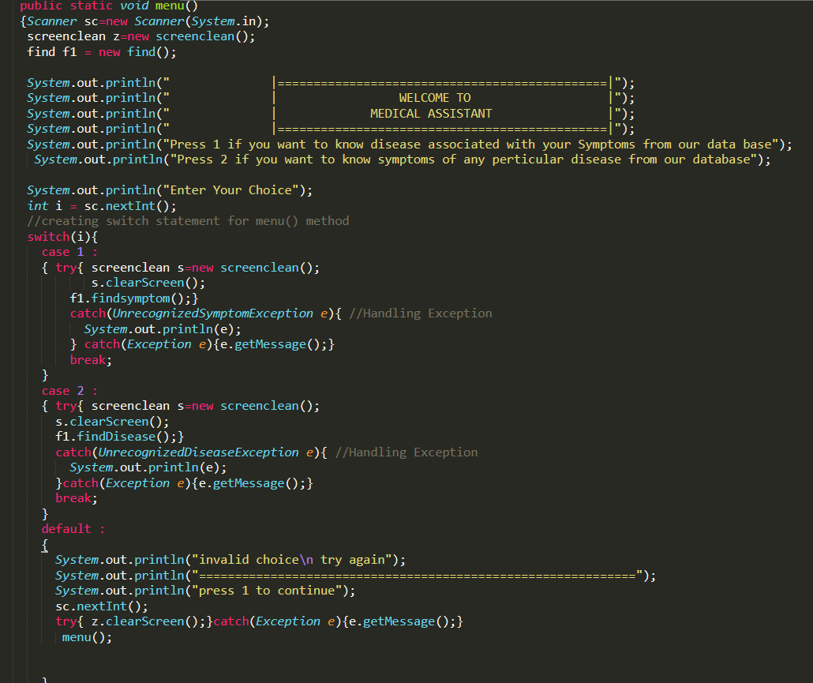
Defining menu() method
creating switch statement for menu() method
Handling Exception

Slide 14
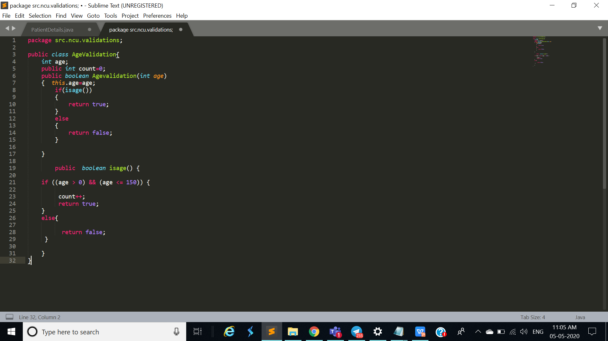

VALIDATIONS
Will be valid only if it lies between the range mentioned
Age Validation-
Will be valid if user enters “m for male” and “f for female” (both capital or small)Anything other than these 4 letters would be invalid
Gender Validation-

Slide 15
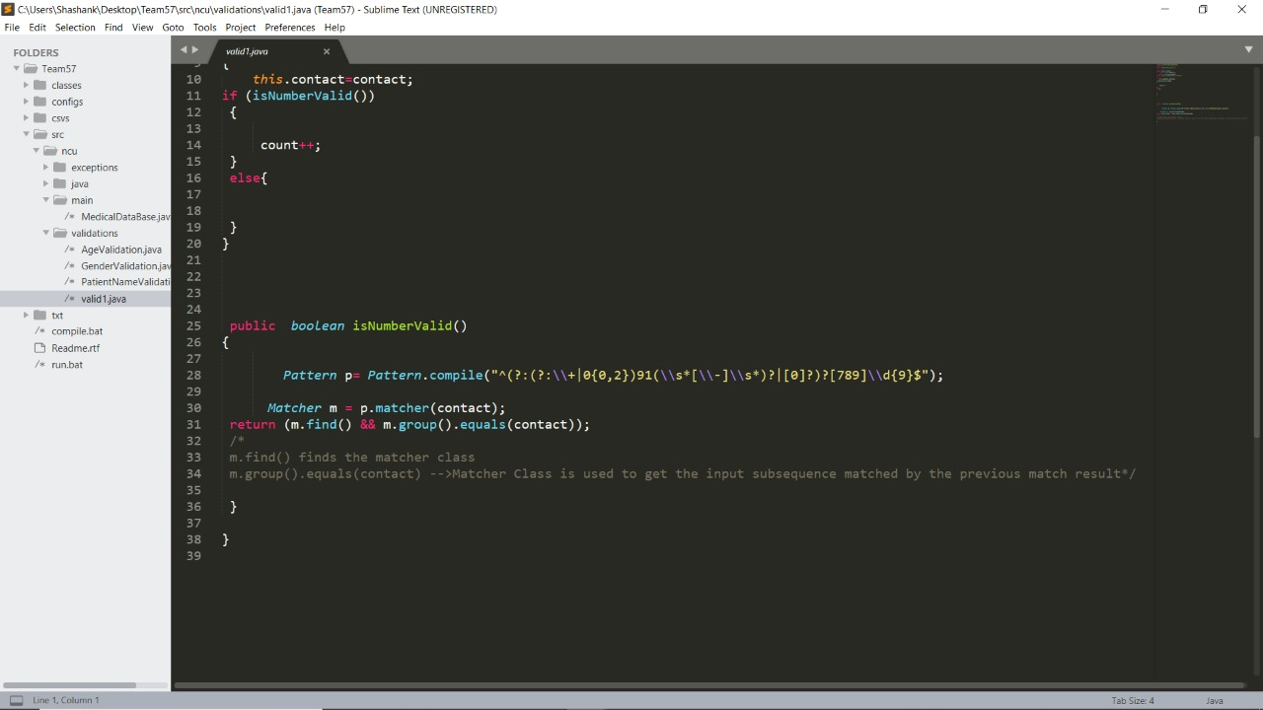
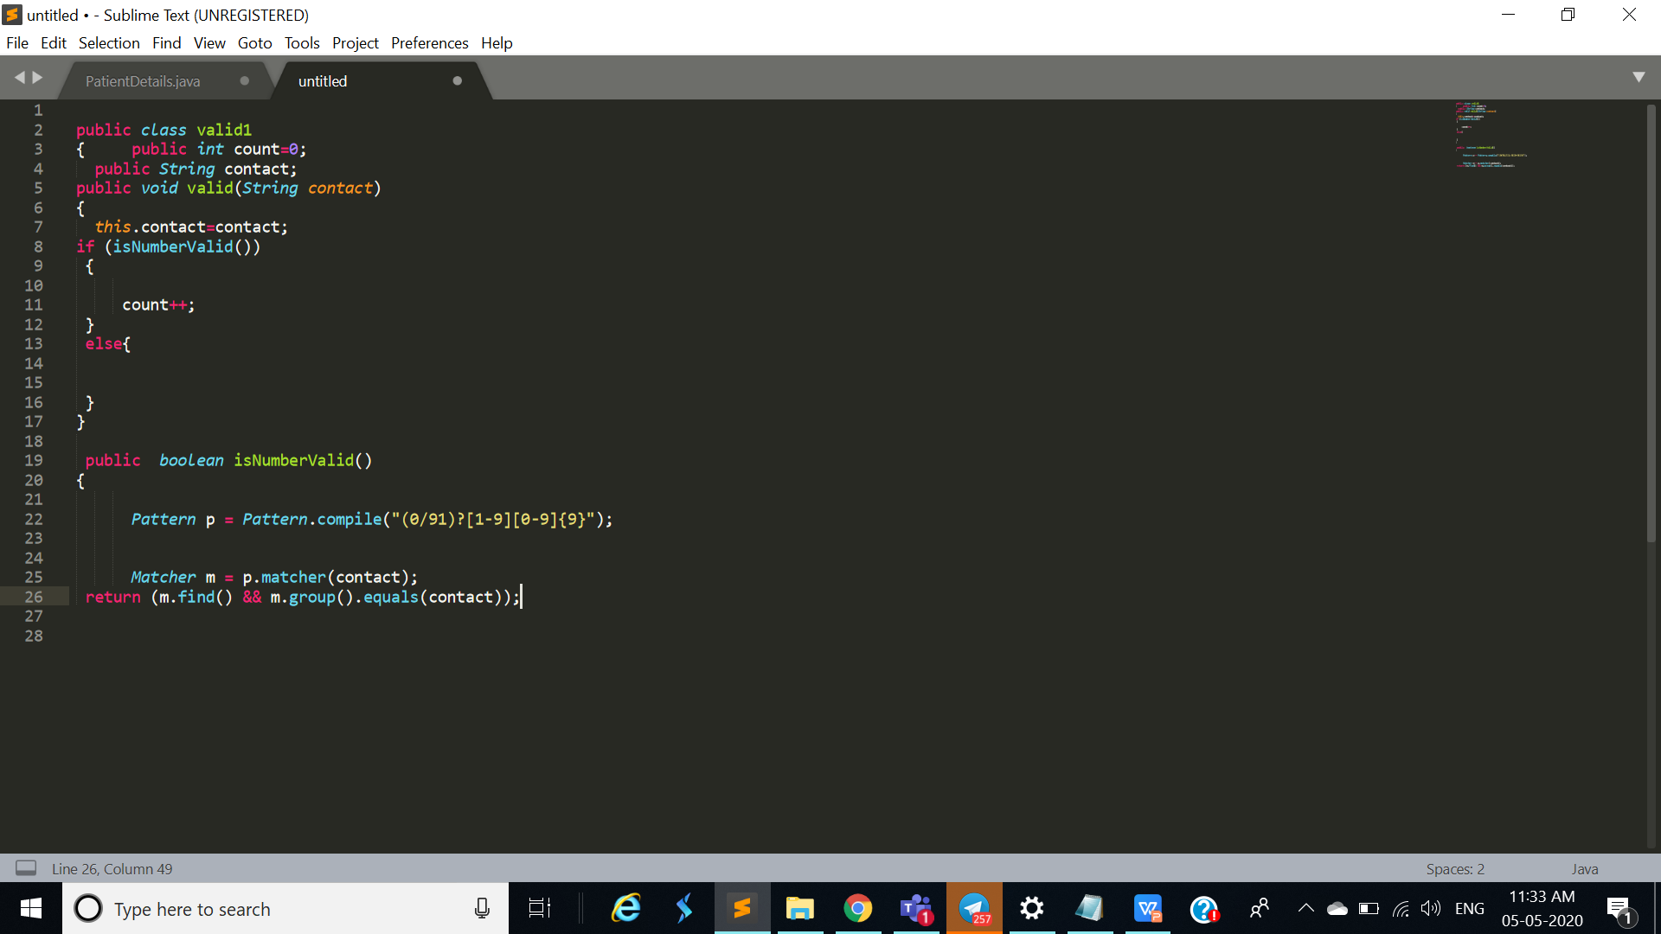
Contact Number validation-
Find() Method of Matcher object checks for the pattern defined by Pattern object
Matcher m=p.matcher(String target);
It will take input of forms-
No. should be of 10 digits starting with 7,8 or 9.
No. could have 0 or 91 in starting other than the 10 digits.
No. could have “+” before 91
No. could have - after 91
returns the entire portion of the input that matched.

Slide 16
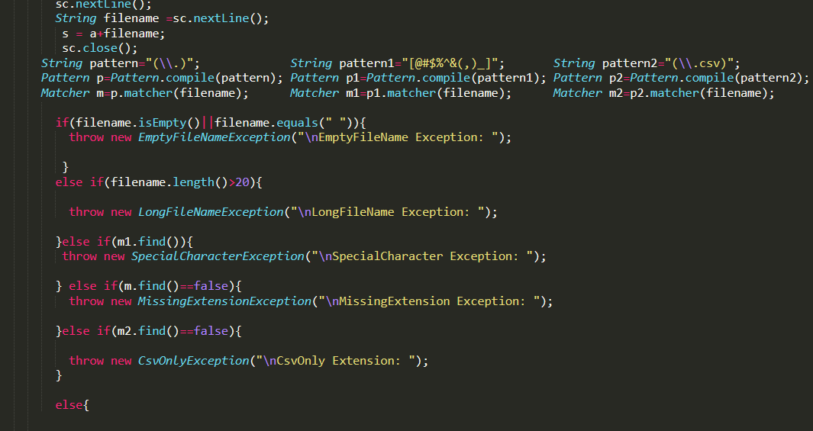
File Validation-
Here we are checking that string length should be within the range
If the file name contains more than 20 character then it will show a message.
Here we are checking that the filename should not be empty.
Here we are checking that the string has any special character or not.
If the string matches that file name contain any special character then it will show message.
If the string matches that the file name do not contain any extension then will throw the Missing Extension Exception.
Here we are checking that the string has dot or not.
If the string matches that file name do not contain the csv extension then it will show the message.
Here we are checking that the string has csv extension or not.

Slide 17
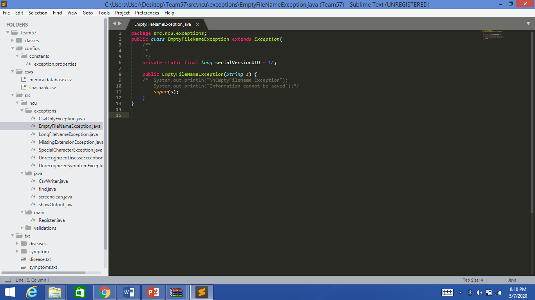
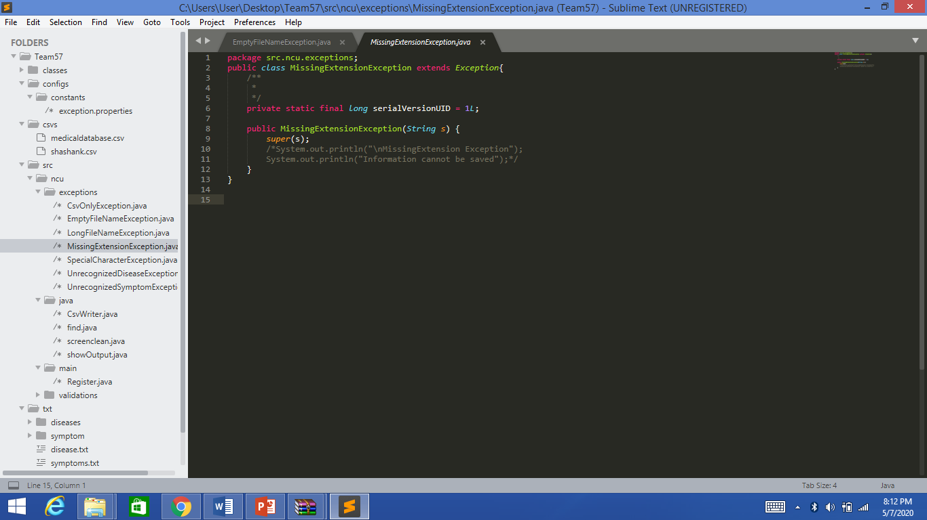
EXCEPTIONS
When no file name is given then this exception will be called
Empty File Name Exception
When there is no extension given in the file name then this exception is called
Missing Extension Exception

Slide 18
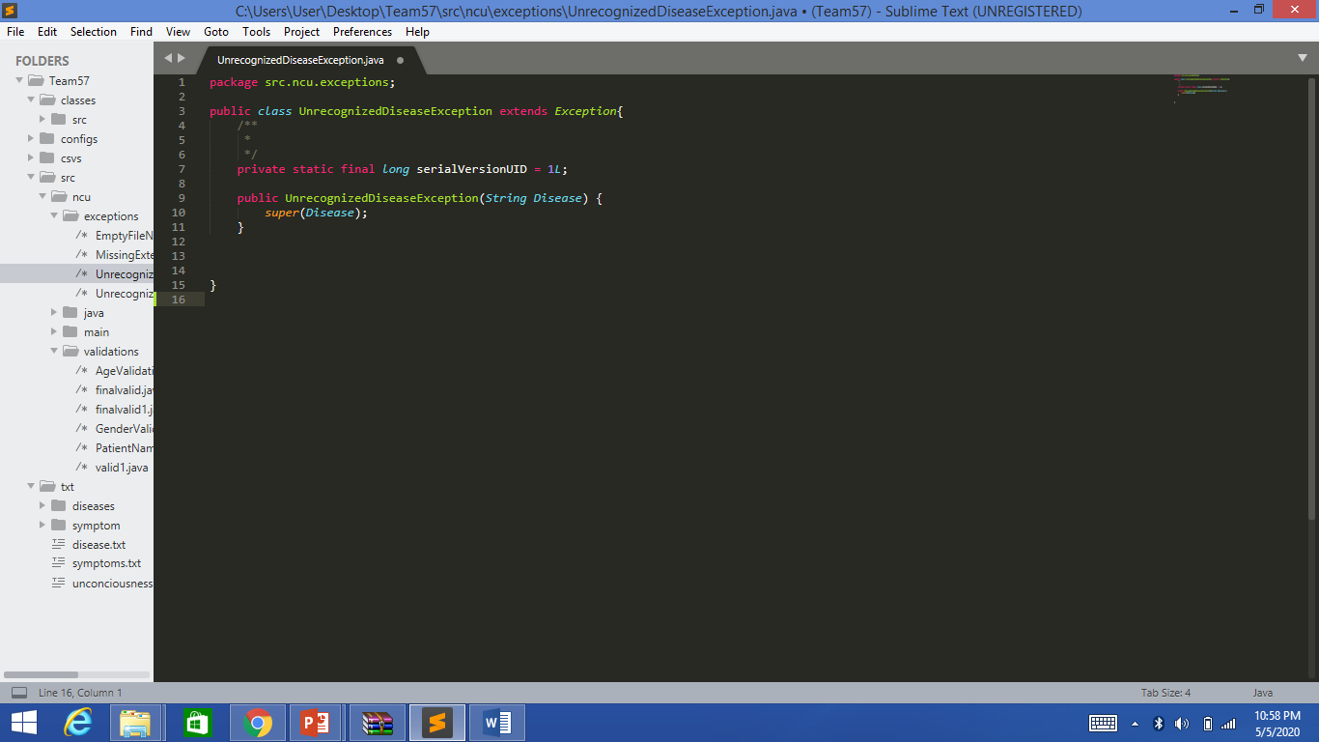
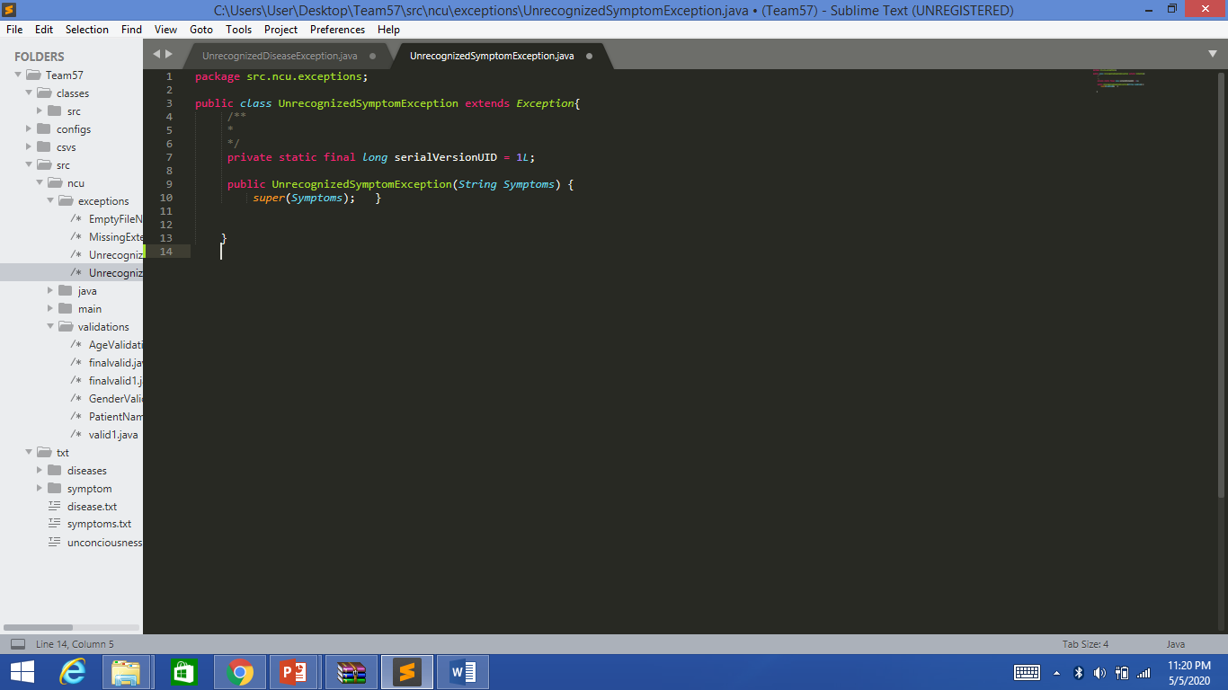
This exception is called when the user has to enter the disease and the disease is not found in the text file
Unrecognized Disease Exception
This exception is called when the user has to enter the symptoms and the symptom is not found in the text file .
Unrecognized Symptom Exception

Slide 19
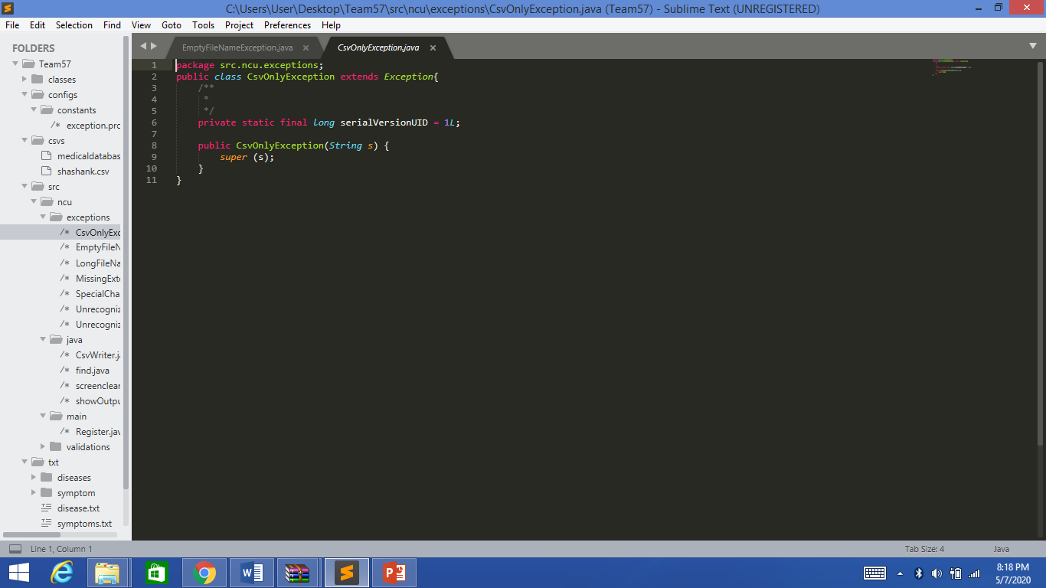
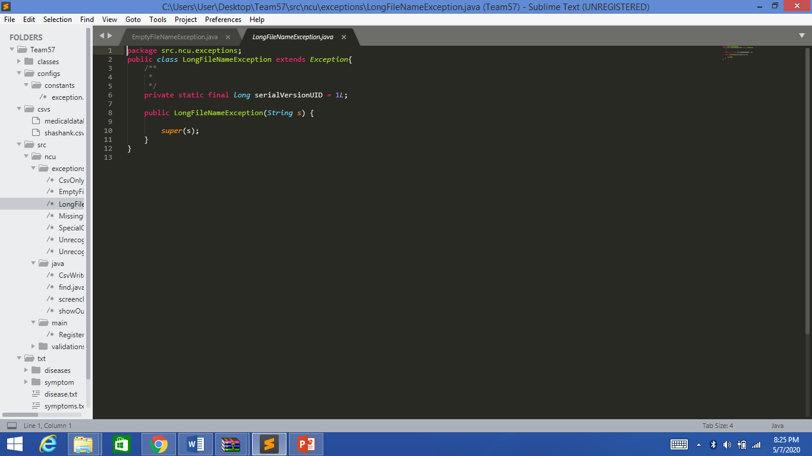
When the file name do not contain csv extension then this exception is called
Csv Only Exception
When the file name
contains more than 20 character this exception is called
Long File Name Exception

Slide 20
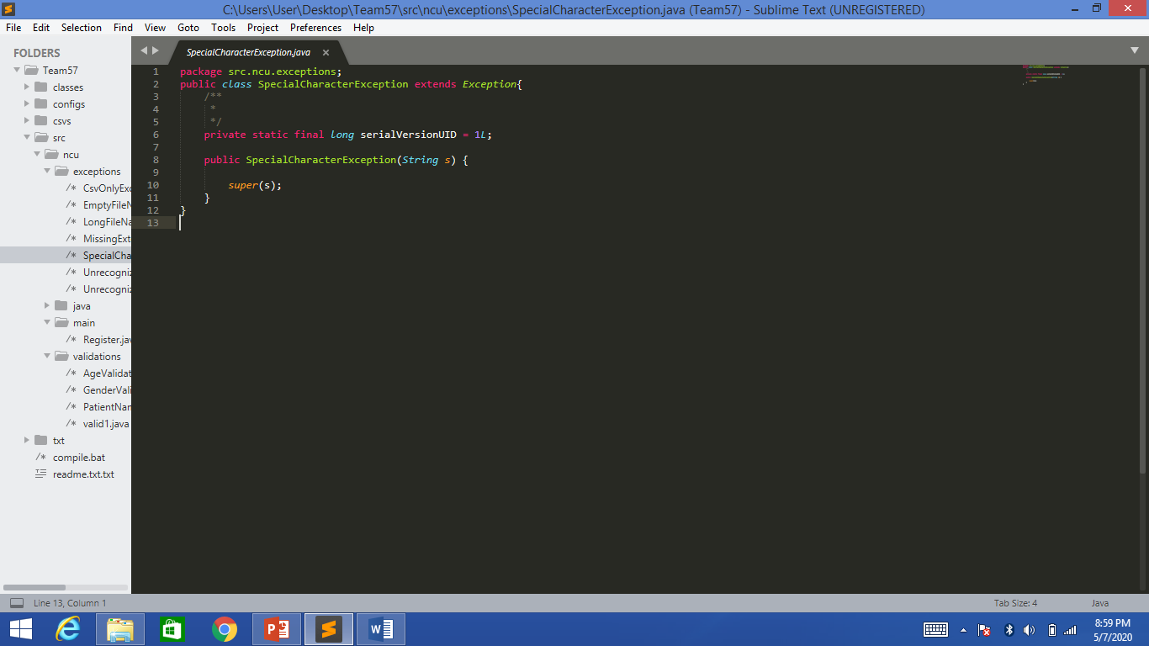
When the file name contain any special character then this exception is called
Special Character Exception

Slide 21
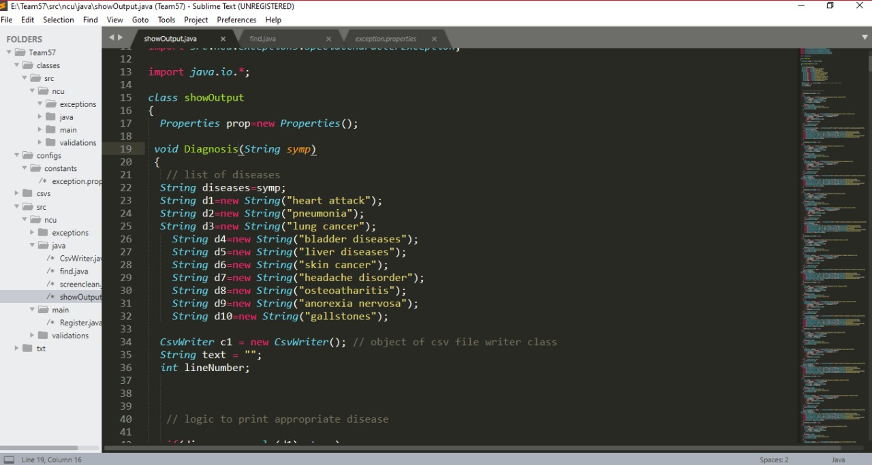
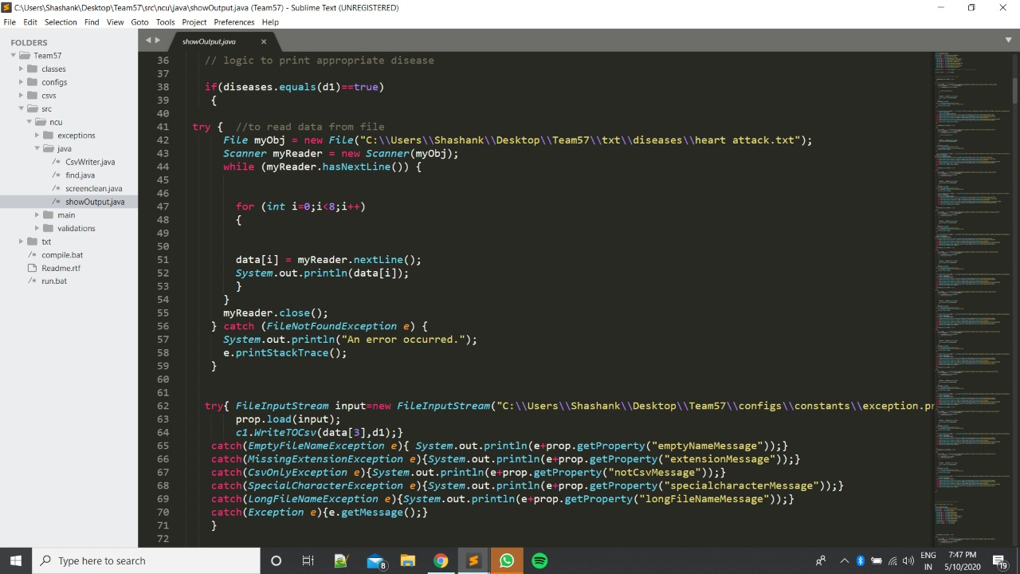
JAVA
The file with the same name as of the entered disease will be opened
Show Output
Entered disease will be compared with all the saved disease.
The file will be read line by line and printed.
It helps to trace the exception, also prints the line number where the exception occurred.

Slide 22
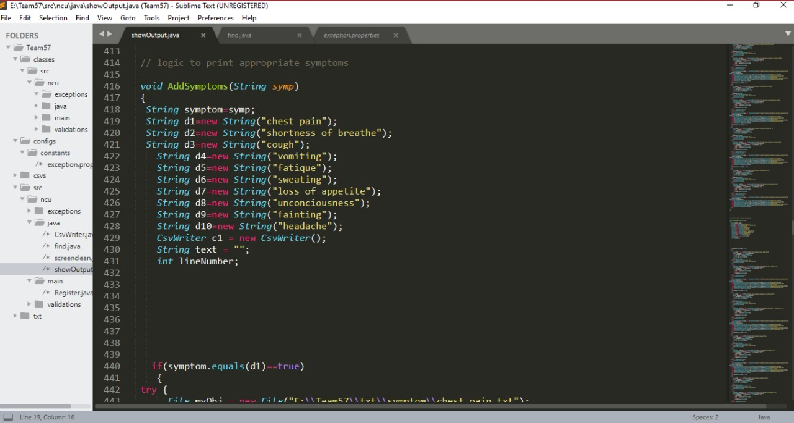
This will do the same but in this we will enter the symptom and the disease will be shown.

Slide 23
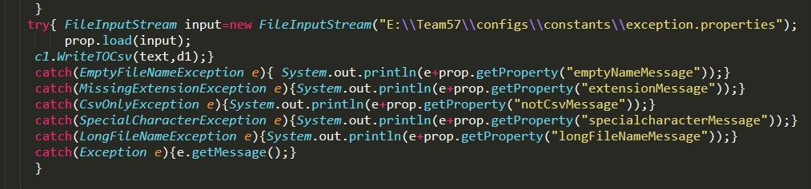
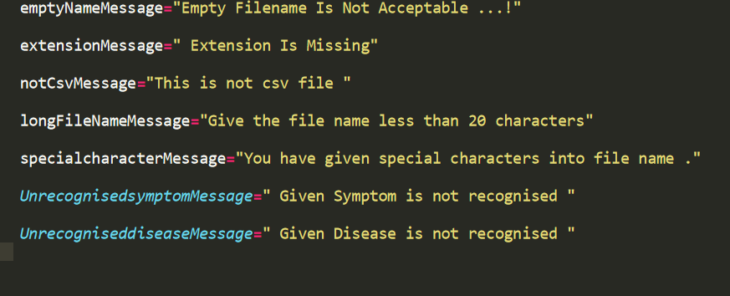
PROPERTY FILE
When any exception is called then it will get the message from the property file
Execution by calling the property file
This is the property file

Slide 24
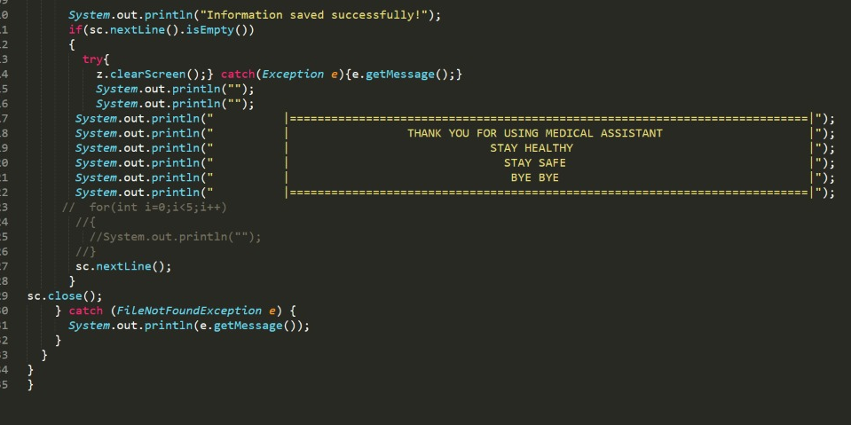

Slide 25
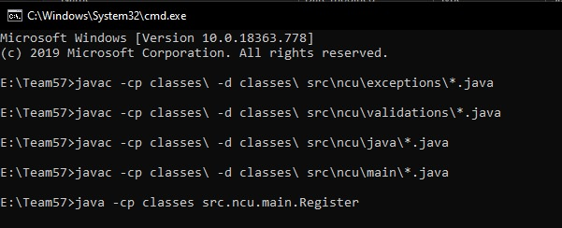
OUTPUT
Command lines for execution of the project

Slide 26
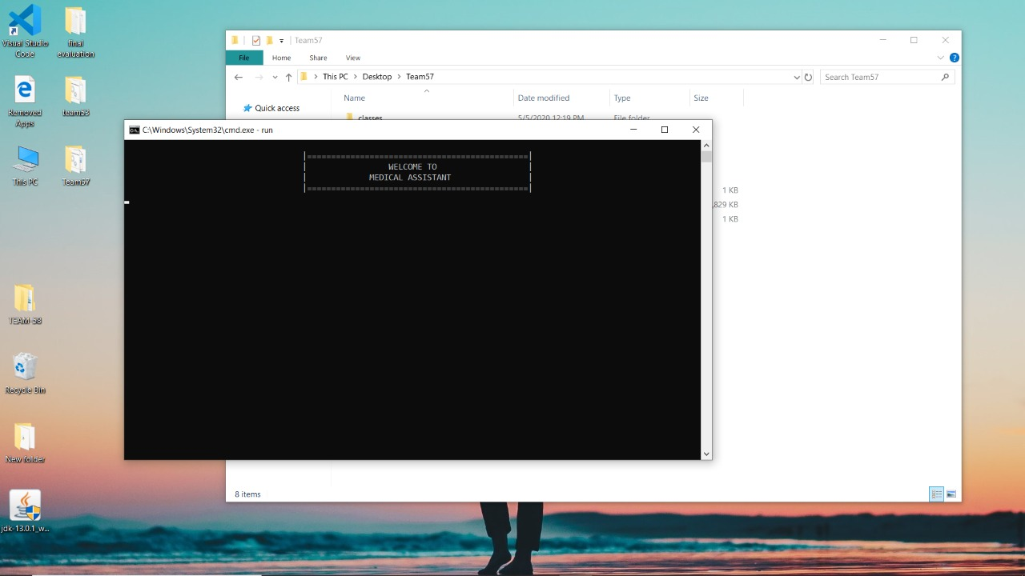

Welcome page
When user press enter
Registration pannel will open

Slide 27
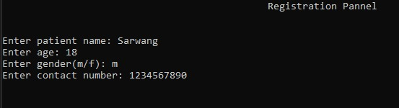
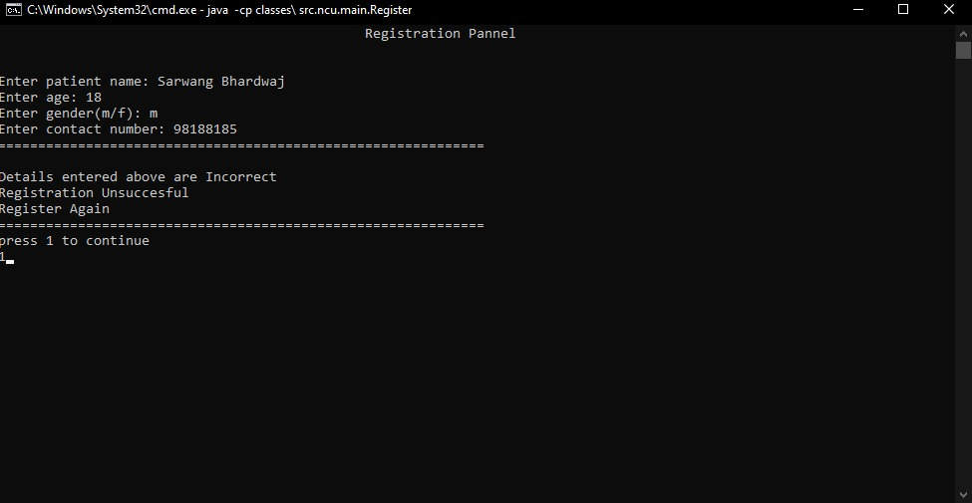
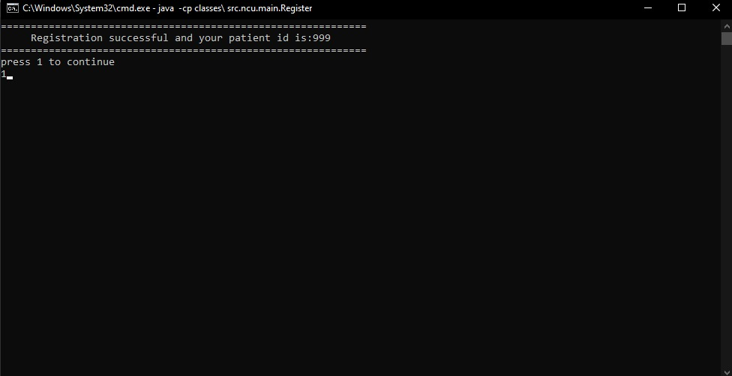
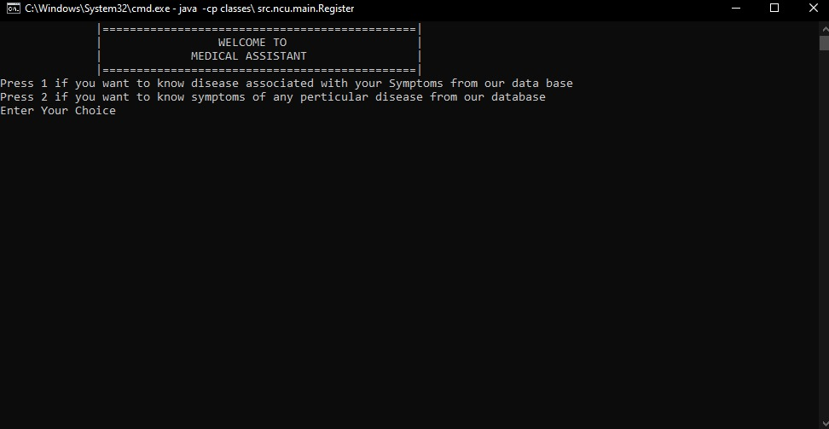
Registration Pannel
If user enter any of the details wrong then the code will not execute further. It will ask user to press 1 and enter the details again
If user enter valid details
An id will be generated and user will be asked to press 1 to continue
Main Menu
Asks user to enter their choice

Slide 28
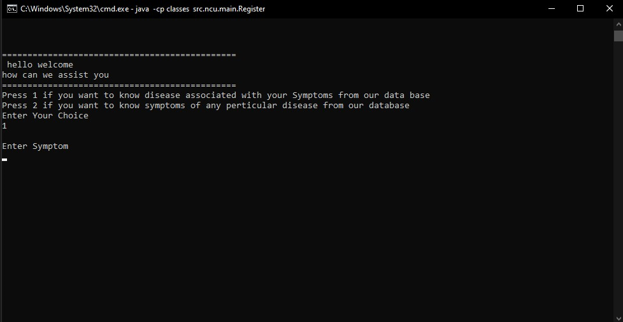
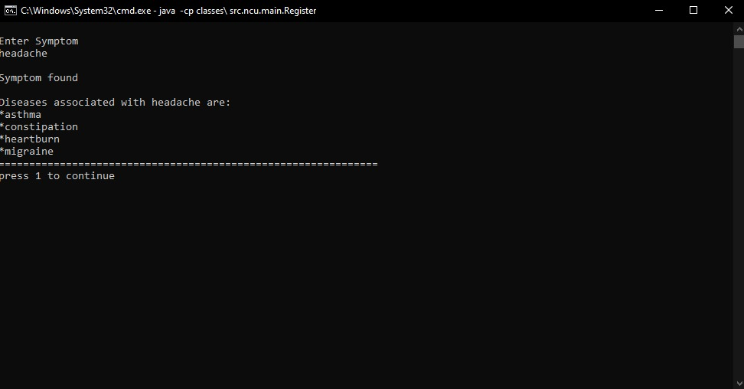
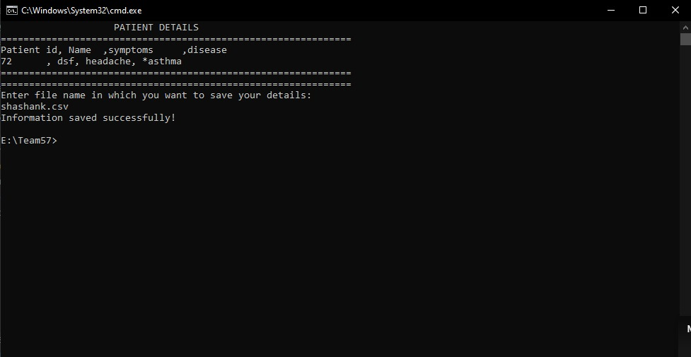
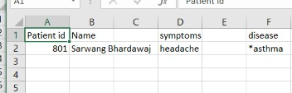
If user press 1 then a print statement will appear to enter symptoms
Disease associated with the symptom entered will be displayed
Will ask user to press 1 to continue
Will display all the data on the screen
Asks user to enter the file name where the data is to be stored

Slide 29
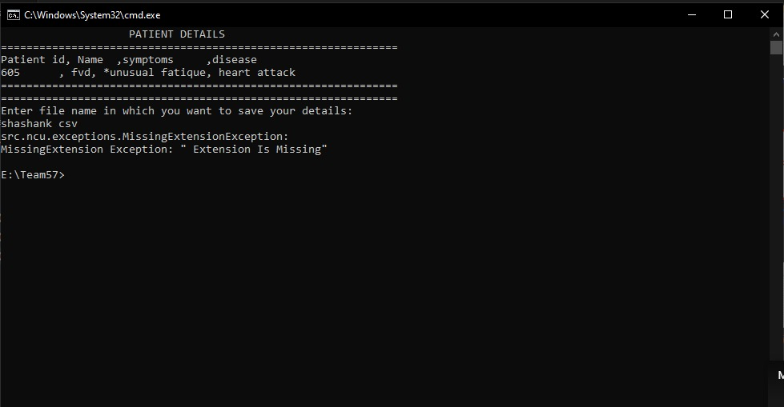
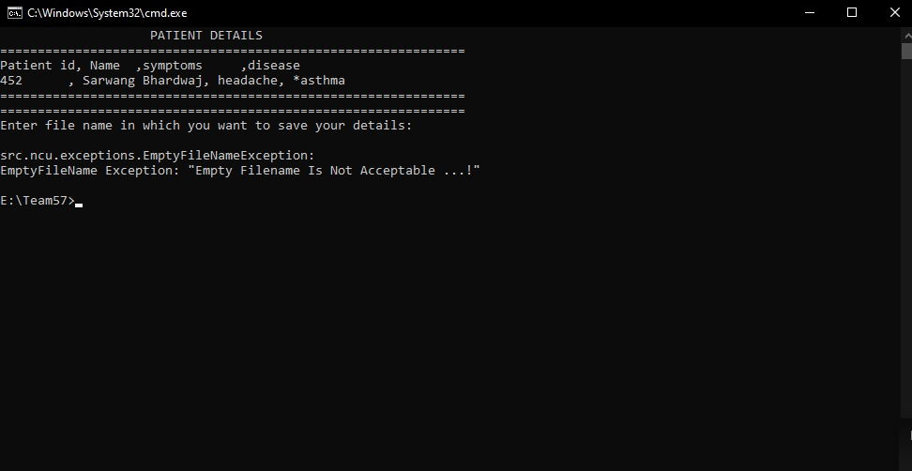
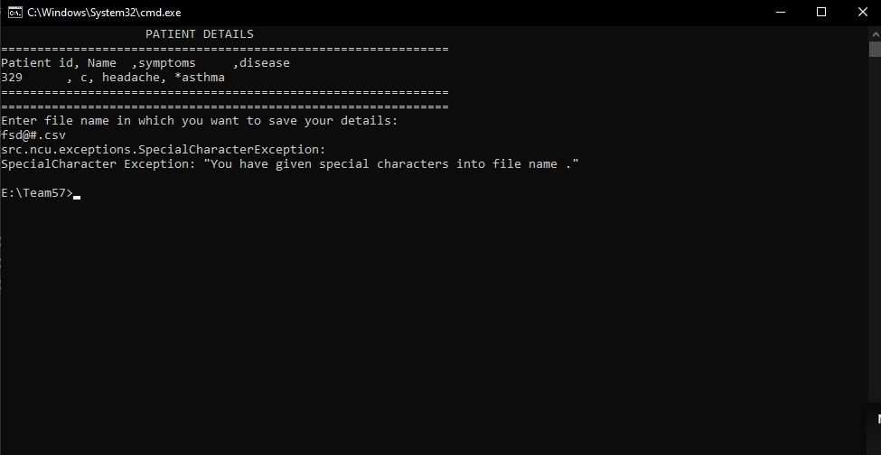
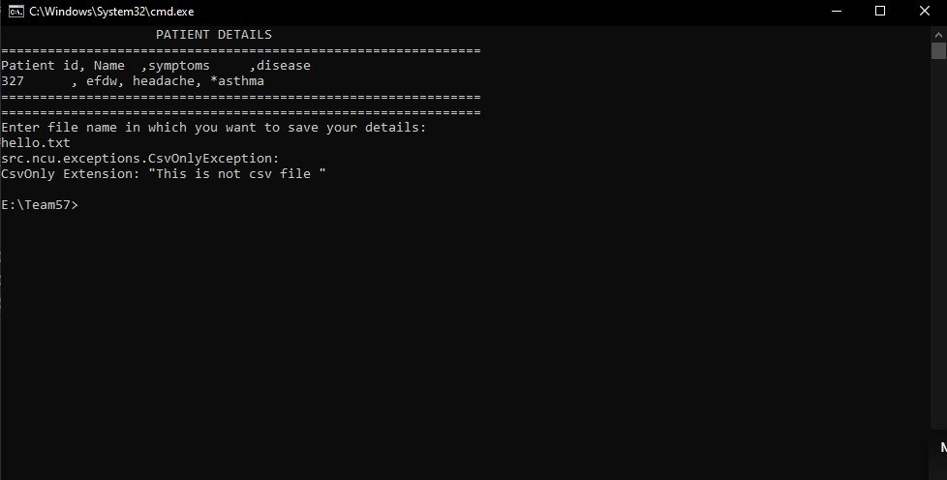
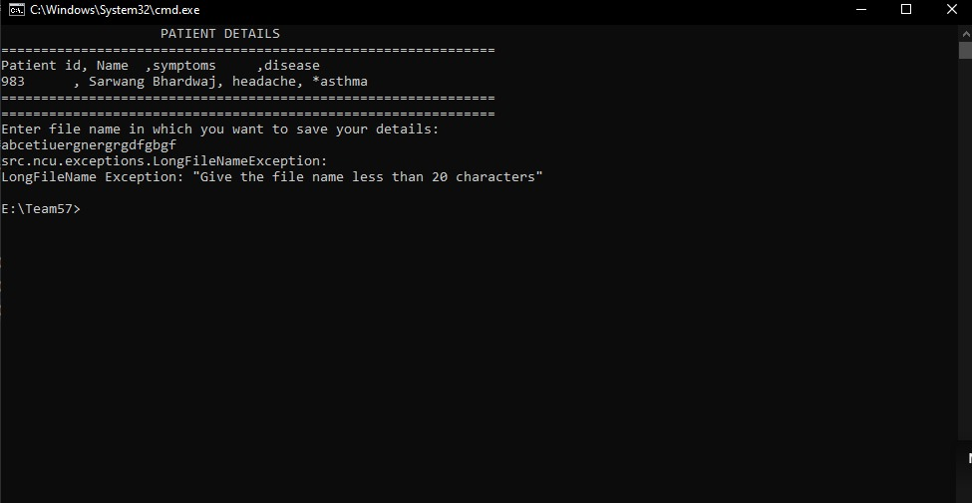
File Name Exceptions
Not in .csv format
It willl display Missing file extension which is taken from from the property file
If user does not enter any file name then it will display empty file name which is taken from the property file
Special Character exception
File name is so long so it will display LongFileName Exception from the property file
Data will be stored only in csv file in .csv format

Slide 30
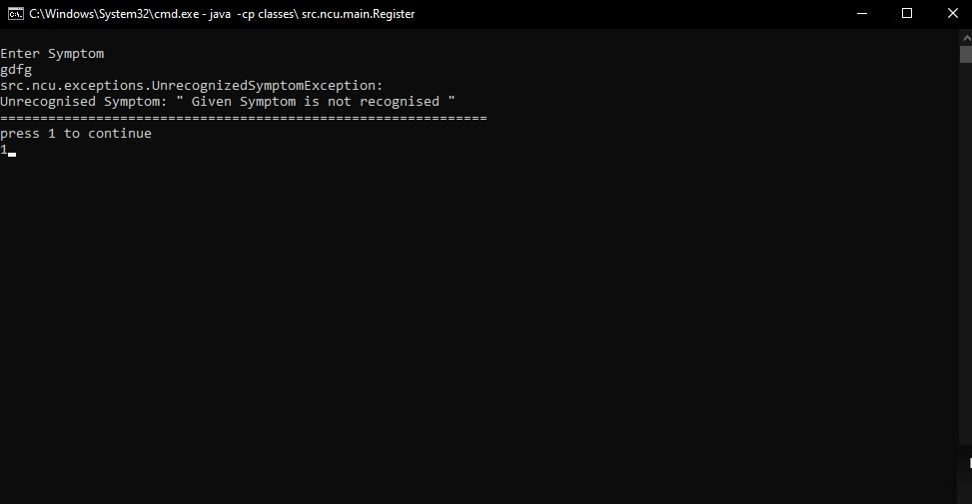
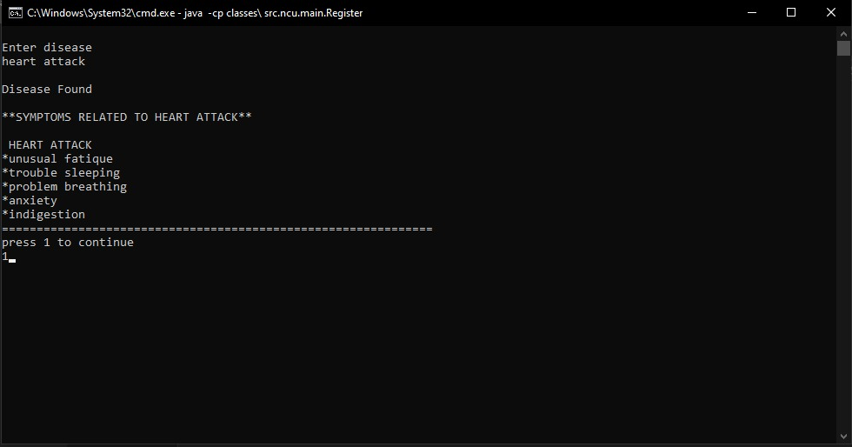
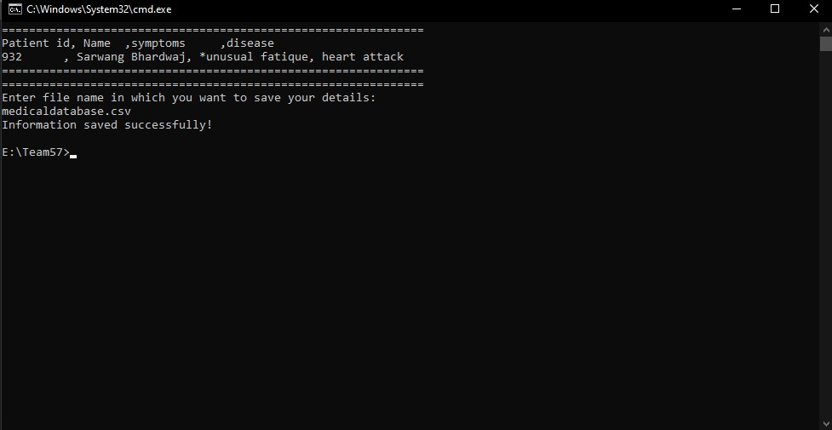
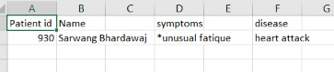
Throws Unrecognized Symptom exception if the symptom added does not appear in the "symptoms.txt" file.And will display Symptom not recongnised from the property file
All the data would be displayed on the screen and user would be asked to enter file name where the data is tbe stored
If user press 2 then user would be asked to enter disease.
Symptoms associated with that disease would be displayed and user would be asked to press 1 to continue
Details stored in csv

Slide 31
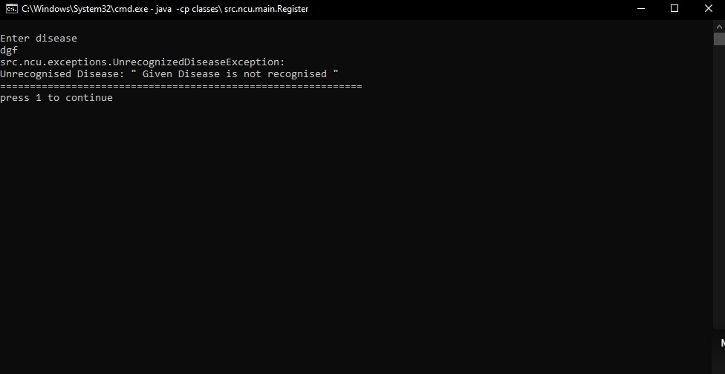
If disease does not appear in the "disease.txt" file then it would throw unrecognisedDiseaseException and would ask user to press 1

Slide 32
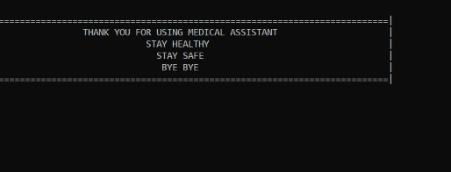
End of the project

Slide 33
THANK YOU

